Slide 1


ICT Health and Safety Training: Best Practices for a Safe Digital Workspace
Presented by Uganda Digital Skills Foundation
Training Date: November 2024

Slide 2

Objectives of the Training
1. To educate participants on safe ICT practices in the workplace. 2. To promote awareness of ergonomic practices to prevent workplace injuries. 3. To guide participants on digital privacy and security practices. 4. To provide strategies for managing screen time and reducing stress.

Slide 3
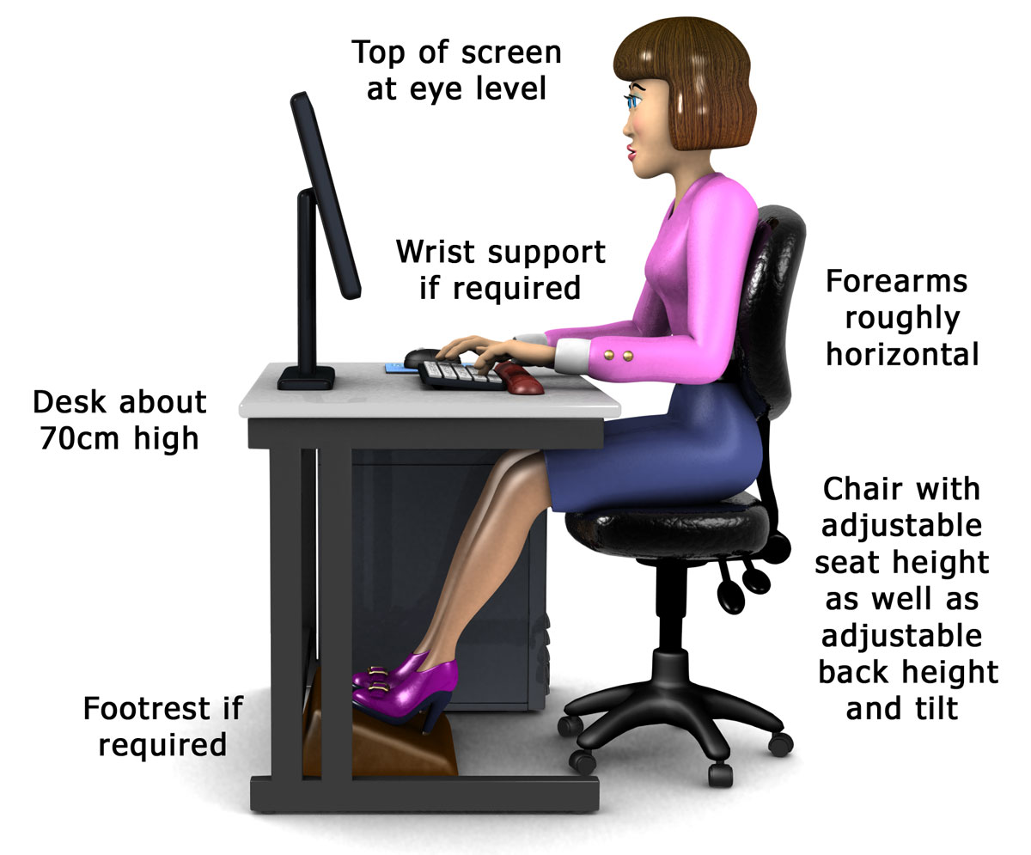

Key Topics Covered
- Workstation Ergonomics - Screen Time Management - Digital Privacy and Security - Stress Reduction Techniques

Slide 4

Practical Exercises
The training included practical exercises such as: - Setting up an ergonomic workstation. - Practicing screen breaks and eye exercises. - Simulating scenarios on digital privacy breaches. - Techniques for managing stress in a tech-based environment.

Slide 5

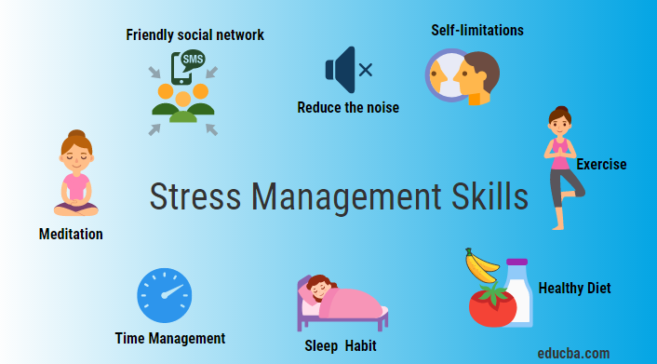
BEST PRACTICES

Slide 6
Summary and Key Takeaways
Participants gained insights on: - The importance of ergonomic workstation setup to prevent injuries. - Techniques to manage screen time effectively. - Practices to protect personal and professional data online. - Strategies to manage stress in high-demand digital environments. Overall, attendees are better prepared to foster a safe and healthy digital workspace.

